Slide 1
Post Invasion Companies in Russia
Travis Lindeman

Slide 2
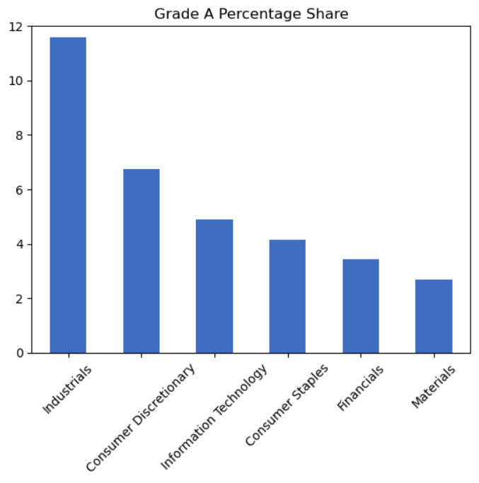
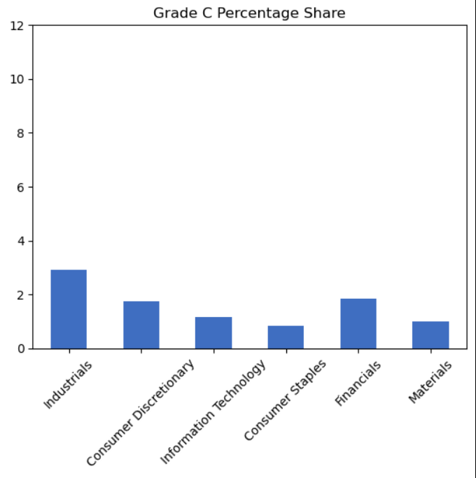
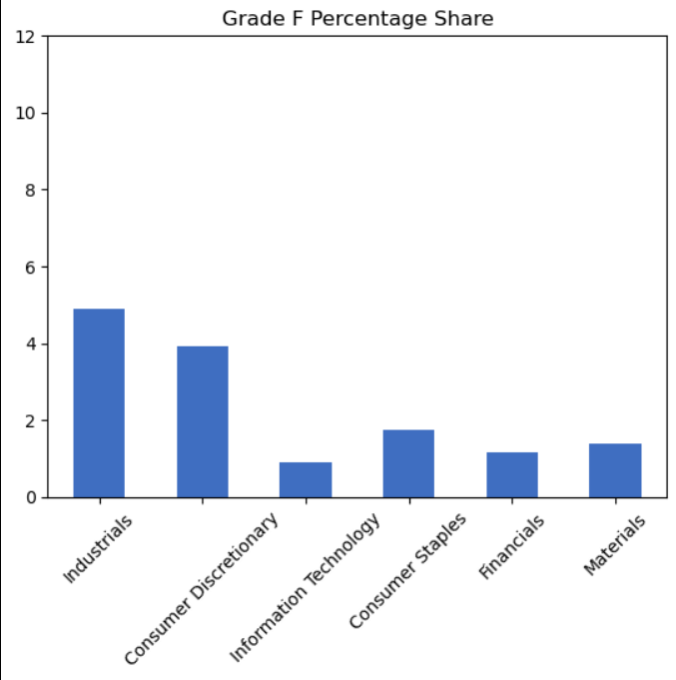
Comparison by Industry and Letter Grade: Biggest Six Industries

Slide 3
Add a Slide Title - 1

